Slide 1
Data Analytics Insights

Slide 2
Introduction
Atliq Hardwares, a leading computer hardware
producer, required data-driven insights, achieved
through SQL queries for data extraction and Power BI
visualizations to analyze trends, sales performance,
and cost structures.

Slide 3
01
Market Overview

Slide 4
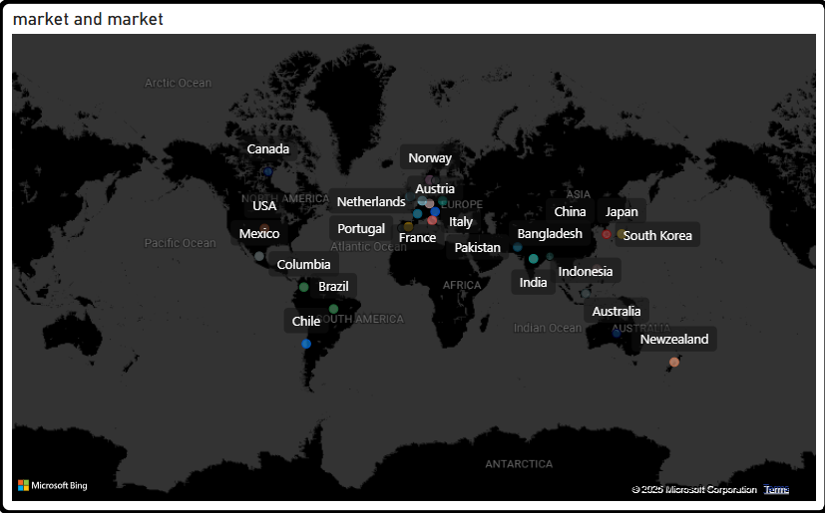
Market Operations

Slide 5
02
Product Analysis

Slide 6
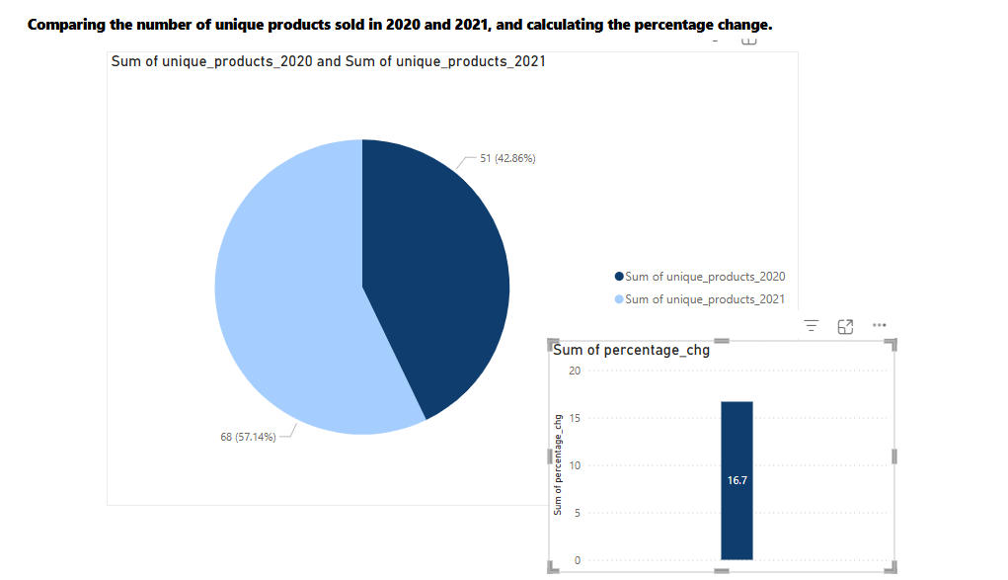
Unique Products Growth

Slide 7
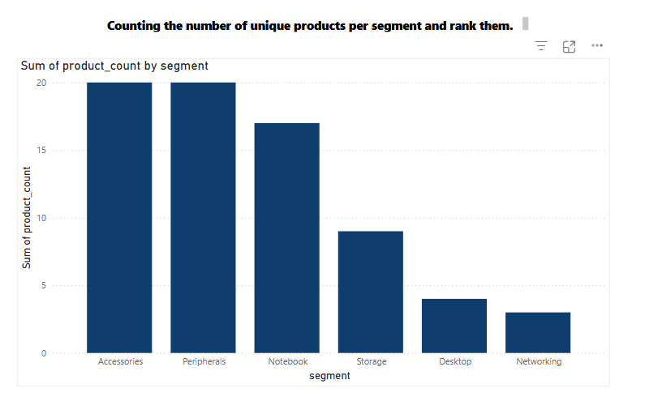
Product Segmentation Comparison
Accessories, Peripherals, and Notebook segments dominate sales by quantity.

Slide 8
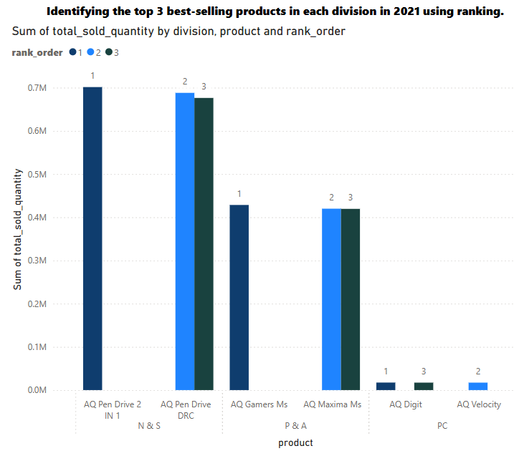
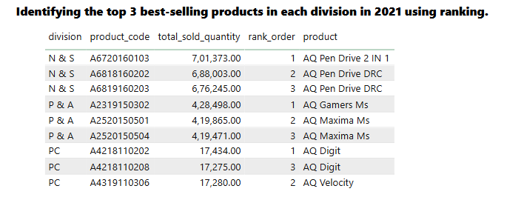
Best-Selling Products Identification
Identifying top-sellers helps optimize inventory and refine marketing efforts, focusing on products that drive revenue.

Slide 9
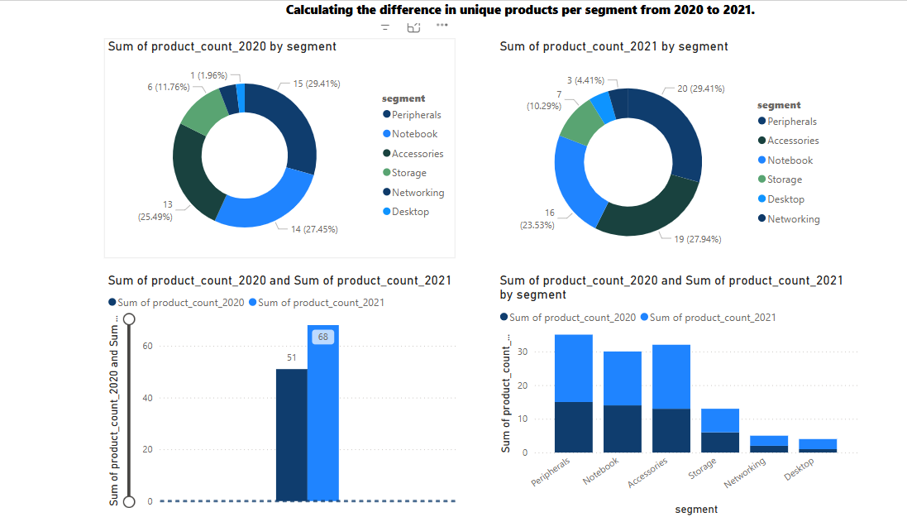
Fastest Growing Segment
Peripherals segment showed the highest increase in unique products.
.

Slide 10
03
Sales Performance

Slide 11
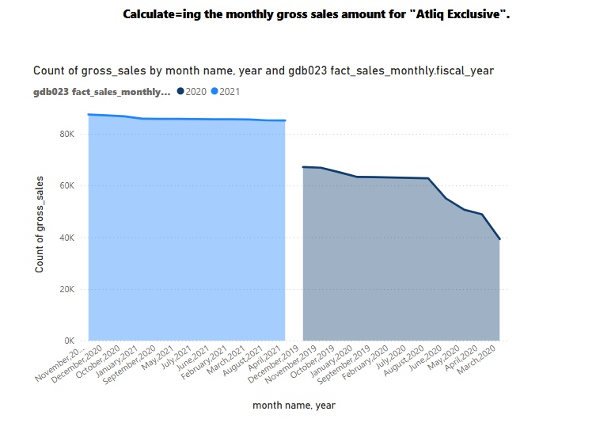
Monthly Sales Trends
Analyzing trends in gross sales provides insights into overall performance and aids in forecasting future sales.
Atliq Exclusive’s highest sales were in November 2020; lowest in March 2020.

Slide 12
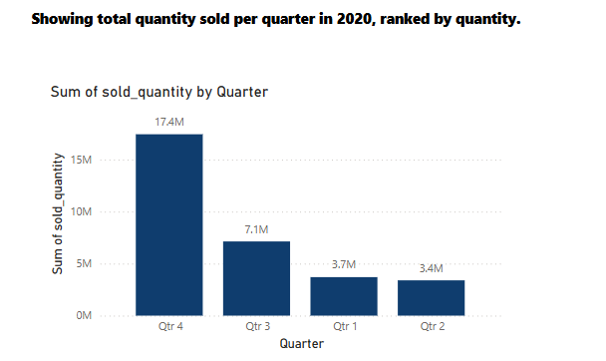
Quarterly Performance Metrics
Assessing quarter-to-quarter performance helps identify strengths and weaknesses, driving timely strategic adjustments.

Slide 13
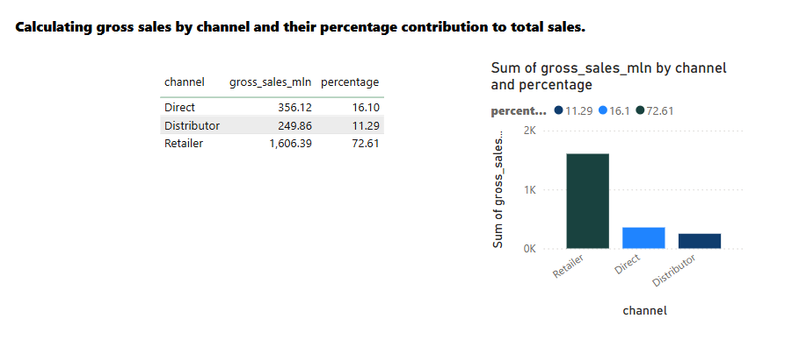
Channel Contribution Analysis
Evaluating sales contributions from various channels provides insight into which pathways yield the most revenue, guiding resource allocation.
Retailer channel contributed 72% to the gross sales in 2021.

Slide 14
04
Cost Analysis

Slide 15
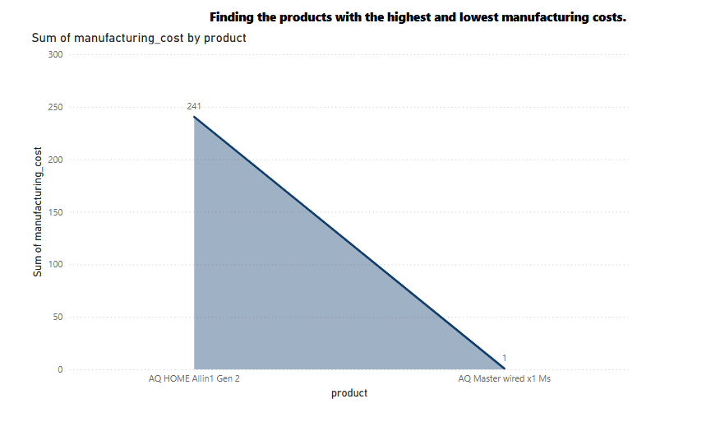
Manufacturing Cost Breakdown
A detailed breakdown of manufacturing costs helps identify areas for potential savings and enhances overall operational efficiency.
Lowest: AQ Master Wired 1Ms ($0.89)
Highest: AQ Home alin1 Gen 2 ($250.53)

Slide 16
05
Customer Insights

Slide 17
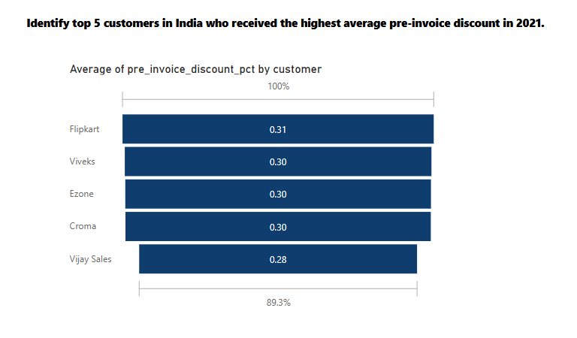
Discount Trends Analysis
Analyzing discount trends helps evaluate the effectiveness of pricing strategies and customer attraction efforts.
Flipkart received the highest average discount among Indian customers in 2021.

Slide 18

Conclusions
In summary, comprehensive analysis of sales, costs, and customer insights will enhance operational effectiveness and strategic direction.

Slide 19
Thank you!

